Slide 1
Unit – 1
Part-A
Solar radiation
Role and potential of new and renewable sources
The solar energy option
Environmental impact of solar power
Structure of the sun
The solar constant
Sun-earth relationships, coordinate systems and coordinates of the sun
Extraterrestrial and terrestrial solar radiation
Solar radiation on titled surface
Instruments for measuring solar radiation and sun shine
Solar radiation data
Numerical problems

Slide 2
Introduction
Energy:
Energy is the ability (capacity) to do work.
Energy sources:
Energy sources are the main sources of energy from which the energy can be extracted and utilized for mankind.
Energy is a key input in economic growth.
The growth of a nation largely depends on the availability of energy resources.
Classification of energy sources:
Primary and secondary energy resources
Commercial and non-commercial energy resources
Sustainable and unsustainable energy sources
Conventional and non-conventional energy resources
Renewable and non-renewable energy resources

Slide 3
Primary energy resources:
Resources available in the nature in the raw form are called primary resources.
Fossil fuels (coal, oil and gas), uranium and hydropower are primary energy resources.
Secondary energy resources:
Secondary energy resources are obtained from primary energy resources by processing.
Electricity, steam, hot water, petrol, diesel, LNG and CNG are secondary energy resources.
Commercial energy resources:
The secondary usable energy resources such as electricity, CNG, LPG, petrol and diesel are essential for commercial activities.
Non-commercial energy resources:
The energy which can be derived directly from nature so as to be used without passing through any commercial outlet is known as the non-commercial energy.
Wood, animal dung cake and crop residues are non-commercial energy sources.
Sustainable energy sources:
Sustainable energy sources are forms of energy that are environmentally friendly, and can be used indefinitely without depleting natural resources or harming the environment.
For example: solar, wind, hydro, geothermal, biomass.
Unsustainable energy sources:
Unsustainable energy sources are finite resources that will eventually run out.
For example: coal, oil, gas.

Slide 4
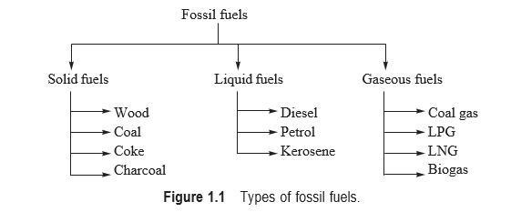
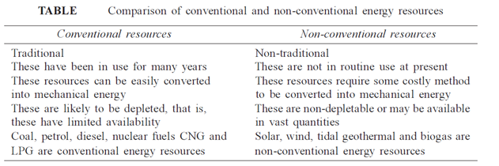
Conventional energy resources:
Conventional energy resources are energy resources which have been traditionally used from many years.
These resources are also widely used at present and likely to be depleted.
Examples: Wood, coal, petroleum and other fossil fuels etc.
Non-conventional energy resources:
These are alternate energy resources to the conventional energy resources which are being considered to be used on large scale.
Examples: Solar, wind, biomass, ocean etc.

Slide 5
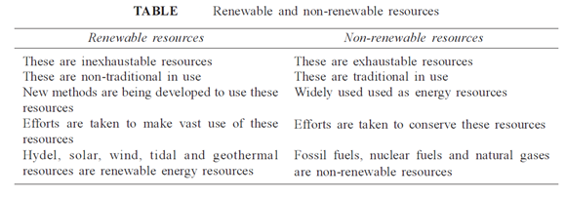
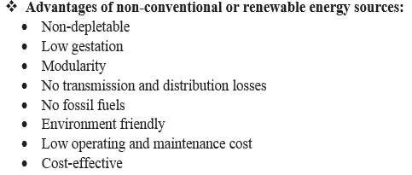
Renewable energy resources:
Resources which can be renewed by nature again and again so that their supply is not adversely affected by the rate of their consumption are called renewable resources.
Examples: Solar, wind, biomass, ocean etc.
Non-renewable energy resources:
Resources which are available in certain finite quantity and cannot be replenished are called non-renewable.
Examples: Coal, petroleum, nuclear fuel etc.

Slide 6
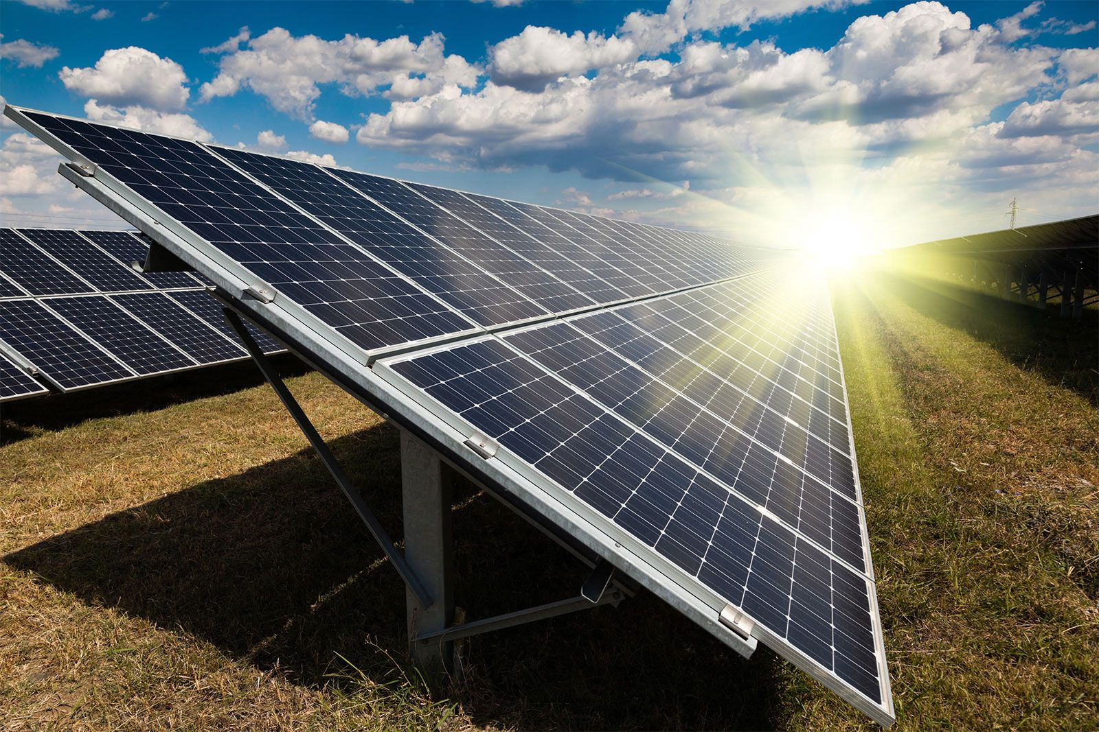

Types of renewable energy systems or sources:
Solar Energy:
The most popular type of renewable source of energy is the light and heat that the sun radiates.
Solar collectors such as photovoltaics, solar heating panels, and so on, are used to collect solar energy, which is then used to provide various forms of electricity.
Wind Energy:
Wind energy is the energy we derive from the wind.
Windmills are the most common way that this energy is sourced and these windmills are used for multiple purposes such as pumping out groundwater, generating electricity, etc.
Up to 4% of our current global energy consumption is accounted for by wind energy.

Slide 7
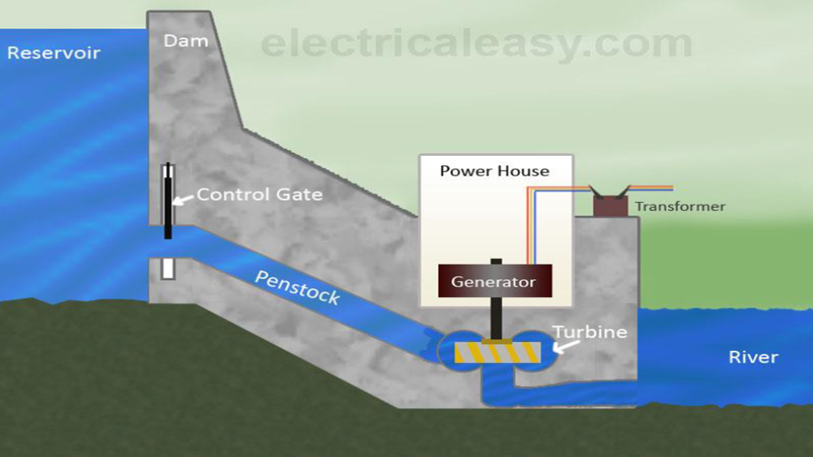
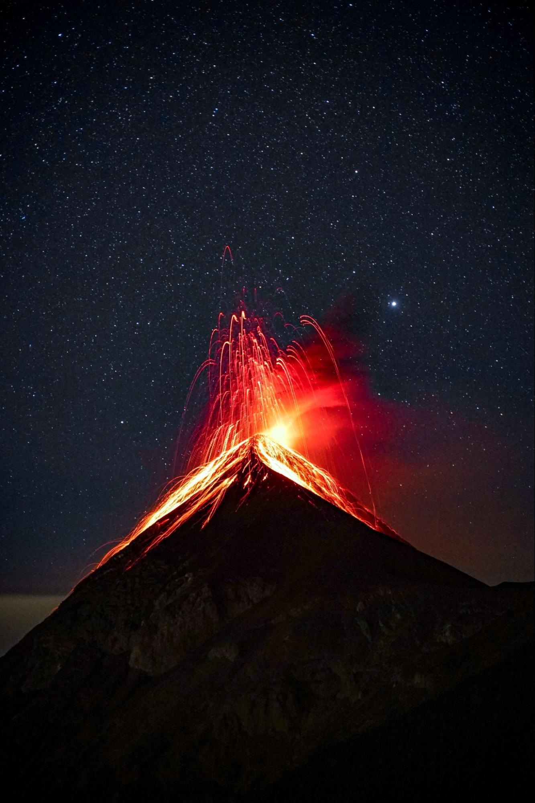
Hydroelectricity:
Hydroelectricity refers to the power generated through the force of water.
The kinetic energy that is a result of the flowing water is used by dams and reservoirs to generate electric power.
Hydroelectricity generates about 70% of all renewable electricity.
Hence, hydroelectricity is the biggest renewable source of energy that we currently have access too.
Geothermal Energy:
Geothermal energy is the heat energy present in the interior of the earth.
Volcanoes are visible signs of large amounts of heat lying in the earth interior.

Slide 8
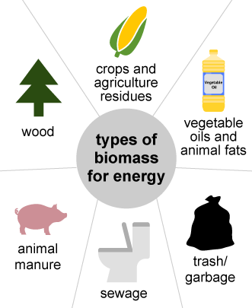
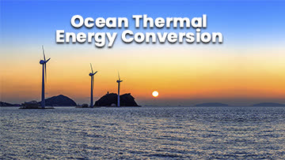
Biomass Energy:
Living organisms and materials derived from plants also create a type of energy which is known as Biomass energy.
Biomass is combusted (exposed to heat) to produce more heat.
Ocean thermal energy:
Ocean thermal energy is created by solar energy when ocean water absorbs solar radiation.
So, the temperature difference between the ocean's surface and deep waters to generate electricity.
Ocean thermal energy, also known as Ocean Thermal Energy Conversion (OTEC), is a renewable energy technology.

Slide 9
Role of new and renewable sources:
The role of new and renewable sources occurs by the following important parameters those are:
Climate change:
To reduce green house gas effect
To reduce global warming
To reduce ozone layer depletion
To reduce acid rains
Energy crisis:
Lack of fossil fuel resources
Hike of fossil fuel prices
Energy security:
Fuel reserves like sun and wind
Renewable in nature
Energy sustainability:
Energy consistency
Inexhaustible energy sources

Slide 10
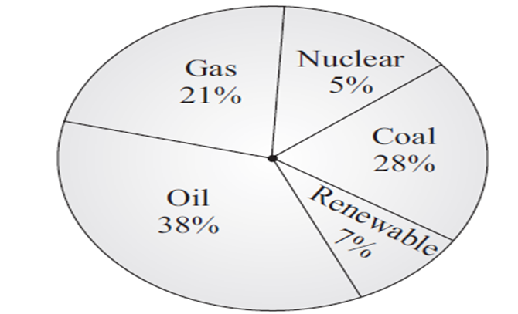
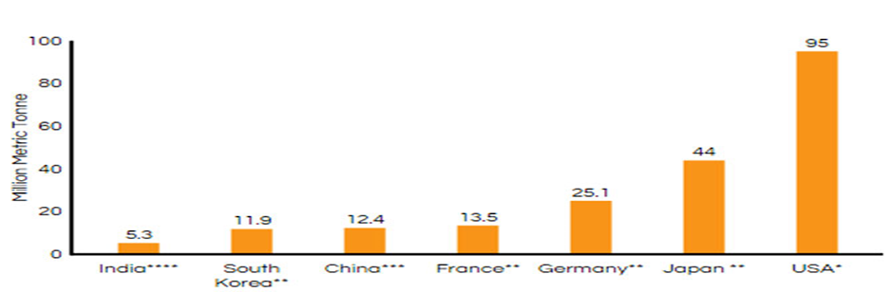
Potential of new and renewable sources:
Energy is one of the major inputs for the economic development of any country.
In the case of the developing countries, the energy sector assumes a critical importance in view of the ever-increasing energy needs requiring huge investments to meet them.
Global energy scenario:
The average percentage consumption of various primary energy resources in the world is shown is figure.
There is currently heavy dependence on fossil fuels. Nearly 87% of the world energy supply primarily comes from fossil fuels.
Fig: Graphical representation percentage consumption of energy sources in the world
Fig: Graphical representation of global strategic petroleum reserves

Slide 11
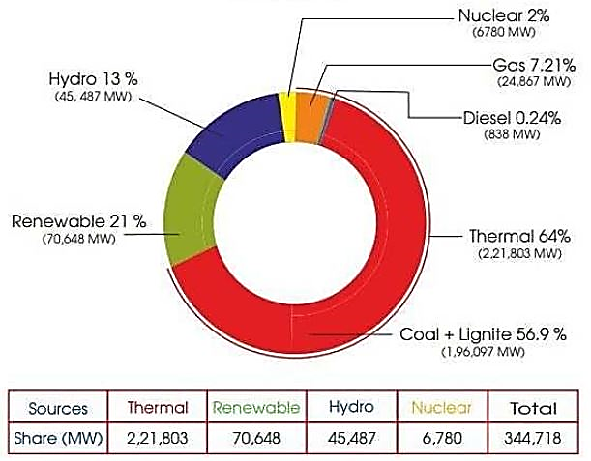
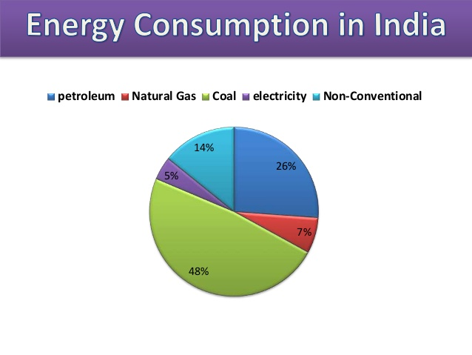
National (India) energy scenario:
In our country energy is tapped from both non-commercial (Fire wood, animal dung etc.) and commercial sources (coal, natural gas etc.).
The amount of energy generation and consumption in India as mentioned in fig.(a) and fig.(b) respectively, as exposed below.
Fig:(a) Graphical representation amount of energy generation in India
Fig:(b) Graphical representation Amount of energy consumption in India

Slide 12
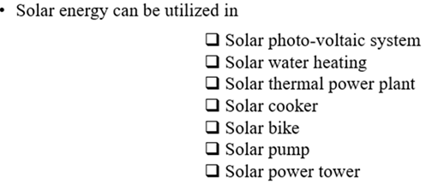
The solar energy option:
Solar power is energy from the sun that is converted into thermal or electrical energy.
Solar energy is the cleanest and most abundant renewable energy source available.
The sun is the primary source of energy for life on earth, radiating light and heat in all directions.
The sun, like other stars, is a huge spherical object made of hydrogen and helium.
The sun's energy comes from a process called nuclear fusion.
Nuclear fusion is a chain reaction that occurs in the sun's core when hydrogen atoms collide and fuse to create helium. This process produces vast amounts of heat and light.
Solar cell panels are used to convert this energy into electricity.
The sun is not only made of the glowing gas that we see with a telescope. It has, exactly like the earth, different layers at different temperatures. Every layer has its own features.

Slide 13
Environmental impact of solar power:
Solar power offers significant environmental benefits and negative impacts.
Benefits:
Renewable and sustainable:
Solar energy is a renewable resource, meaning it can be replenished naturally, making it a sustainable energy source.
Reduced greenhouse gas emissions:
Solar power plants do not emit greenhouse gases during operation, unlike fossil fuel plants. This helps mitigate climate change and reduce the harmful effects of air pollution.
Cleaner air quality:
By replacing fossil fuel-based electricity generation, solar power reduces the release of air pollutants that contribute to respiratory problems and other health issues.
Water conservation:
Solar photovoltaic (PV) systems require minimal water for operation, unlike traditional power plants that use large amounts for cooling. This is particularly beneficial in arid regions.

Slide 14
Potential Negative Impacts:
Land use:
Large-scale solar farms can require significant land areas, potentially impacting habitats and ecosystems.
Hazardous materials:
The manufacturing of solar panels involves the use of hazardous materials, and improper disposal can lead to environmental contamination.
Habitat loss and degradation:
Construction of solar facilities can lead to habitat loss and fragmentation, affecting biodiversity.
Visual impacts:
Solar farms can have visual impacts on the landscape, and some people may find them aesthetically displeasing.

Slide 15
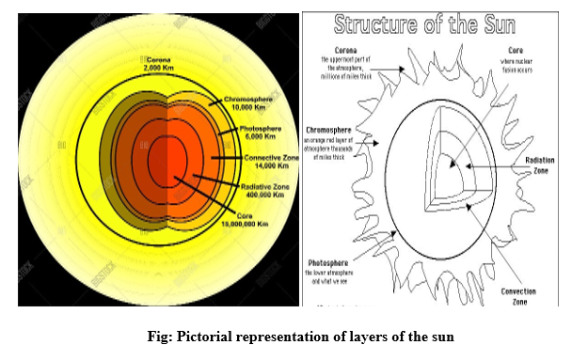
Structure of the sun:
The sun, like other stars, is a huge spherical object made of hydrogen and helium. Its “diameter reaches 1,400,000 km, or 109 times the earth’s diameter”.
The sun is not only made of the glowing gas that we see with a telescope. It has, exactly like the earth, different zones and layers at different temperatures. Every layer has its own features.

Slide 16
Above is a figure of the structure of the sun with all the different zones and layers named.
The core:
The core of the Sun is the source of all its energy.
The amount of energy produced is nearly continuous, so we do not see a considerable variation in its brightness nor the heat that is given off.
The core has a “very high temperature” and the material it is composed of is very dense due to the “extremely high pressure.”
It is the combination of these two properties that creates an environment where nuclear reactions can take place.
These nuclear reactions always produce heavier elements on the periodic table.

Slide 17
The radiative zone:
The transport of energy from the Sun’s core (where it is produced) to the regions that surround it can be done by transferring it by radiation.
This is how it travels from the centre of the Sun to the outer regions, hence the name “radiative zone”.
Through this area of the solar interior, the energy (in the form of radiation) is transmitted by its interaction with the particles in the surrounding.
These particles are capable to absorb energy, stock it for a short time, and then later release that energy as new radiation.
In this way the generated energy in the core is passed from one atom to another, wandering on an upwards path, through the radiation zone.
The convection zone:
The energy that is initially created in the core needs a new transport mechanism to carry on its passage to the Sun’s surface once it is out of the radiation zone.
This is necessary since the temperature is relatively cool outside of the radiation zone (“2 million degrees Kelvin compared to 5 million in the radiation zone”).
Atoms will absorb energy much more easily at this temperature, but they do not release it so readily since their surrounding is cool and dense.
Therefore, the energy transfer by radiation slows down considerably.

Slide 18
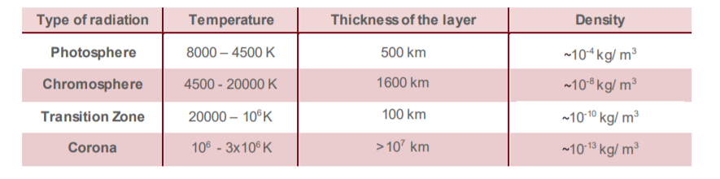
Layers of the Sun:
Solar constant:
Solar constant is defined as the energy received from the sun per unit time on a unit surface area perpendicular to the direction of propagation of solar radiation at the top of earth’s atmosphere when earth is at its mean distance from the sun.
The value of solar constant is taken as l367 W/m² .

Slide 19
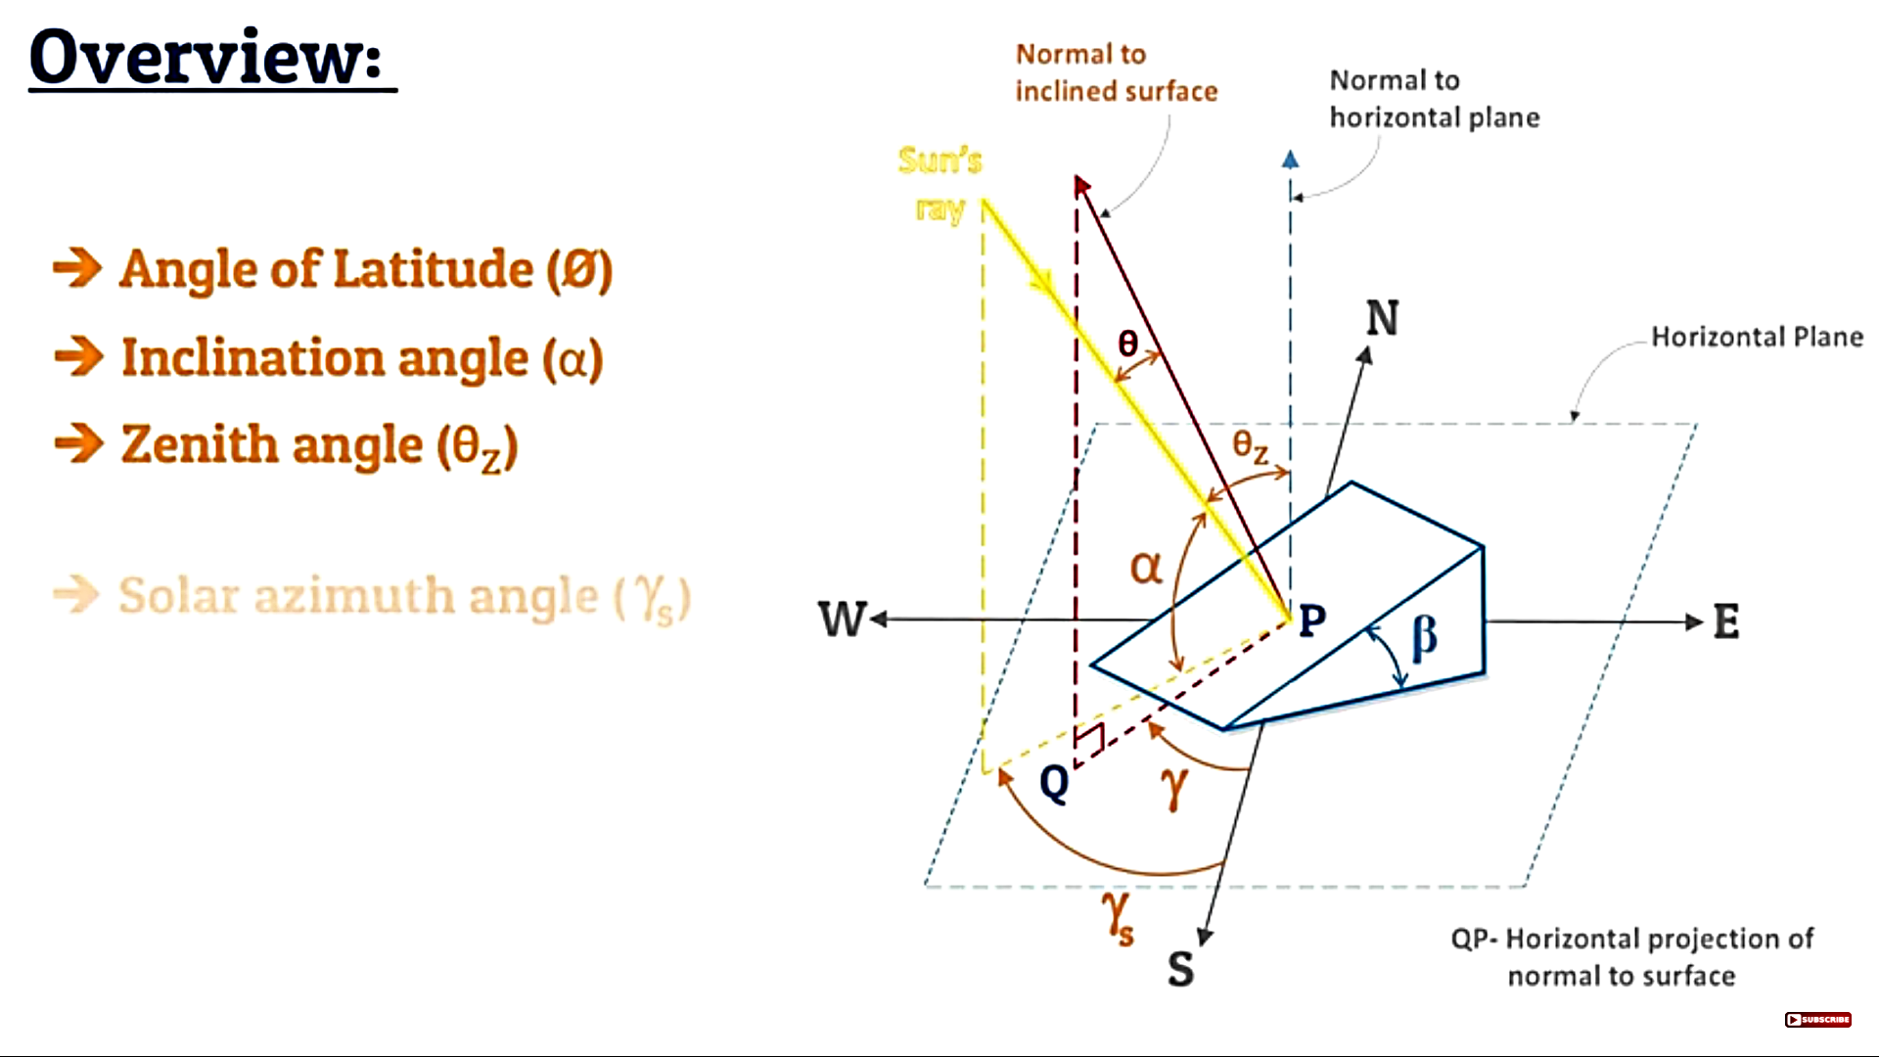
Sun-earth relationships or Sun-earth angles:
Declination angle(δ)
Angle of latitude (λ)
Inclination angle (or) Altitude angle(α)
Zenith angle (θ_{z})
Solar azimuth angle (γ_{s})
Tilt angle or slope (β)
Angle of incidence (θ)
Surface azimuth angle (γ)
Hour angle (ω)
Fig: Sun-earth angles

Slide 20
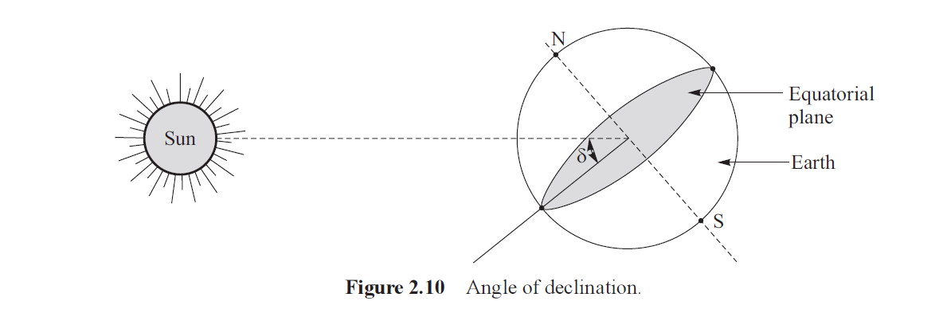
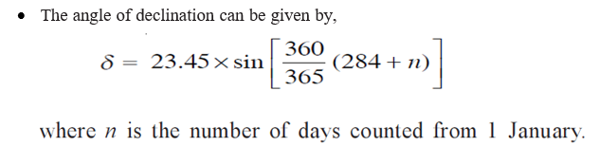
Declination angle(δ):
Fig: Declination angle
It is the “angle made by the line joining the centers of sun and earth with the equatorial plane ” as shown in figure.
Simply, it is the angular displacement of the sun from the plane of the earth’s equator.

Slide 21
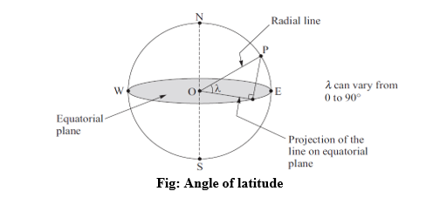
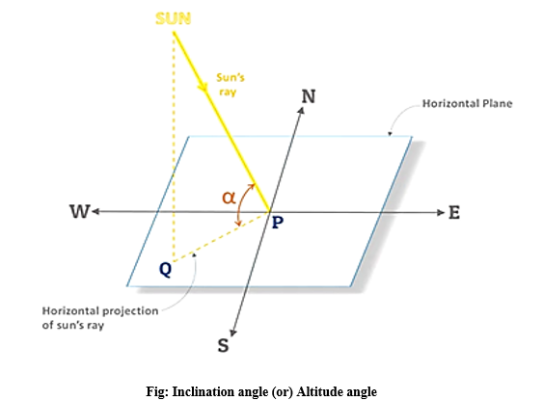
Angle of latitude (λ):
The latitude of a location on earth’s surface is the angle made by the radial line joining the specified location to the centre of earth with the projection of this line on the equatorial plane a s shown in figure.
Simply, it is the vertical angle between the line joining that point of location to the centre of the earth and its projection on equatorial plane.
The latitude at equator is zero and it is 90º at poles.
Inclination angle (or) Altitude angle(α):
It is the angle between sun’s ray and its projection on horizontal surface as shown in figure.
Numerical relation for inclination angle (or) altitude angle is given by,

Slide 22
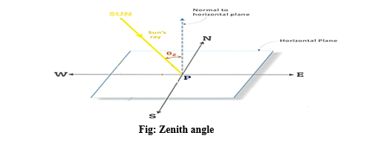
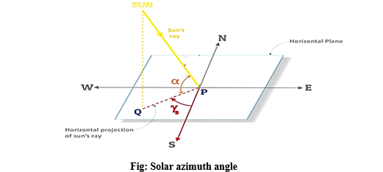
Zenith angle (θz):
It is the angle between sun’s ray and perpendicular (normal) to the horizontal plane as shown in figure.
Also, zenith angle is compliment of inclination (altitude) angle,
i.e., α+θ_{z}=90⁰
⇒ θ_{z}=90⁰- α
Hence, at sunrise zenith angle is +90⁰ whereas -90⁰ at sun set.
Zenith angle for horizontal surface is given by,
Solar azimuth angle (γ_{s}):
It is the angle between the projection of sun’s ray to the point on the horizontal plane and line due south passing through that point.
The value of the azimuth angle is taken positive when it is measuring form south towards west.
The equation of the azimuth angle of sun is given by,
Cos γ_{s} =(cos θ_{z} sin λ -sin δ) /sin θ_{z} cos λ

Slide 23
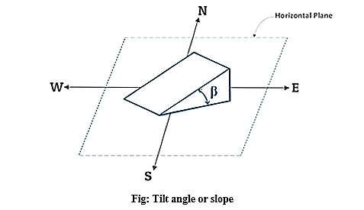
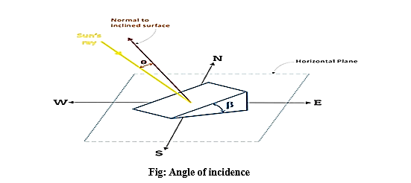
Tilt angle or slope (β):
The tilt angle is the angle between the inclined slope and the horizontal plane as shown in the figure.
For horizontal surface slope (β)=0⁰
Angle of incidence (θ):
The angle of incidence for any surface is defined as the angle formed between the direction of the sun ray and the line normal to the surface as shown in the figure.
Simply, it is an angle between plane surface and normal to that surface.
For horizontal surface, zenith angle(θ_{z}) =Angle of incidence(θ).

Slide 24
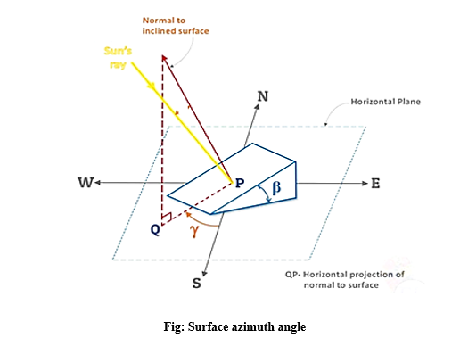
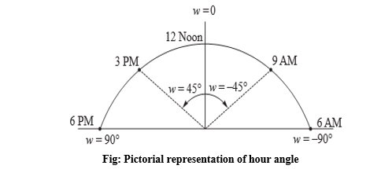
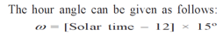
Surface azimuth angle (γ):
It is the angle in horizontal plane between the line due south and the horizontal projection of normal to the inclined plane surface.
It is taken as positive when measured form south towards west.
Most noteworthy, one must make use of the following formula for the purpose of azimuth calculation to the west: γ = 360 – d, where “γ” is the azimuth, one intends to find, and “d” is the distance in the form of degrees from due north.
Hour angle(ω):
It is an angular measure of time.
The hour angle at any instant is the angle through which the earth has to turn to bring the meridian of the observer directly in line with sun’s rays.

Slide 25

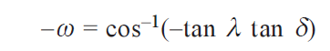
Case (i): At sun rise, hour angle: -
For horizontal surface,
(b) For inclined surface,
ω=cos⁻¹(-tan (λ- β) tan δ)
Case (ii): At sun set, hour angle: -
For horizontal surface,
(b) For inclined surface,
-ω=cos⁻¹(-tan (λ- β) tan δ)
Case (iii): The angle between sunrise and sun set or solar day length can be given as,
(a) For horizontal surface,
(b) For inclined surface,
Solar day length=2ω=2cos⁻¹(-tan (λ- β) tan δ)

Slide 26
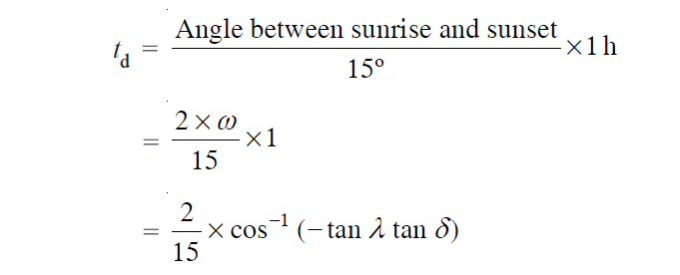

Case (iv): The duration of sunshine hour (t_{d}) or day light hours can be given as,
For horizontal surface,
b) For inclined surface,
t_{d}=$\frac{2}{15}$× cos⁻¹(-tan (λ- β) tan δ)

Slide 27
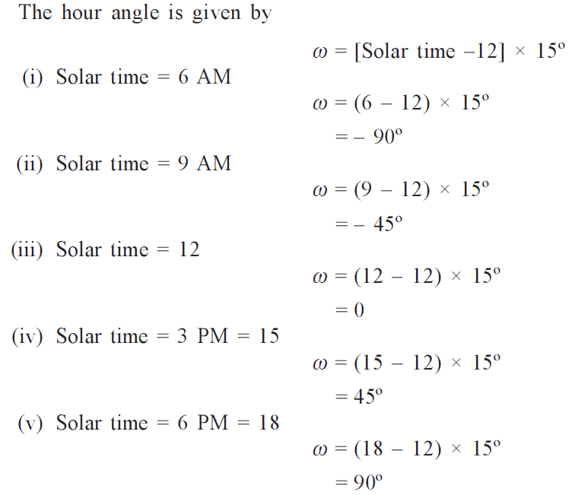
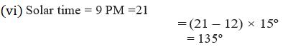
Model numerical problems on basic Sun-earth angles or Sun-earth relationships
1. Calculate hour angle for the local apparent time given by
(i) 6 AM, (ii) 9 AM, (iii) 12 noon, (iv) 3 PM, (v) 6 PM and (vi) 9 PM.
Solution:

Slide 28
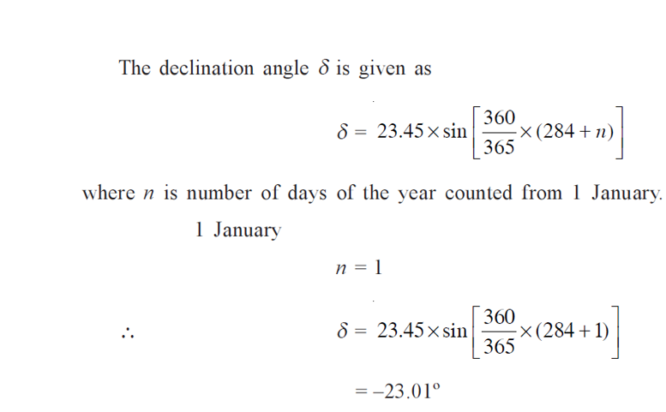
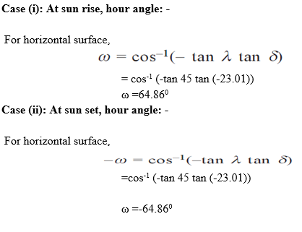
2. Calculate the hour angles at sun rise and sun set for 1 January. Take latitude as 450 N.
Solution:

Slide 29
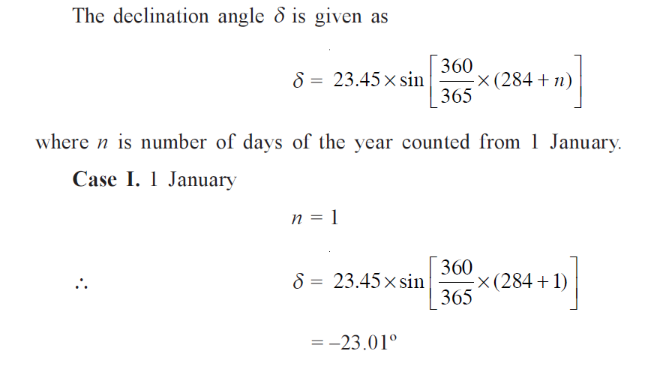
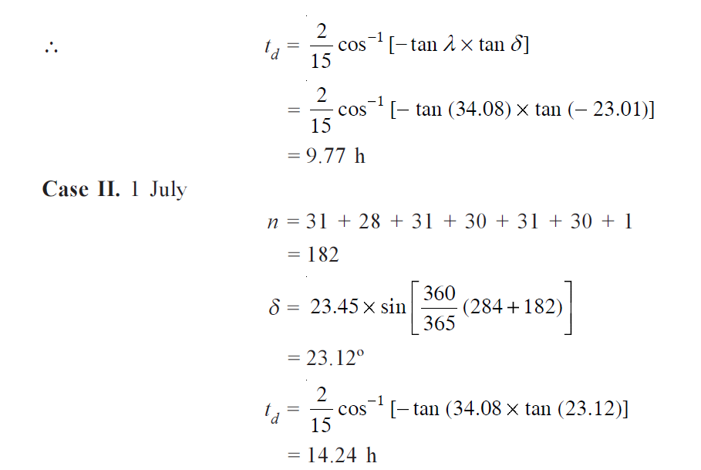
3. Calculate the number of daylight hours in Srinagar for 1 January and 1 July. Take latitude of Srinagar as 34º05' N.
Solution:

Slide 30
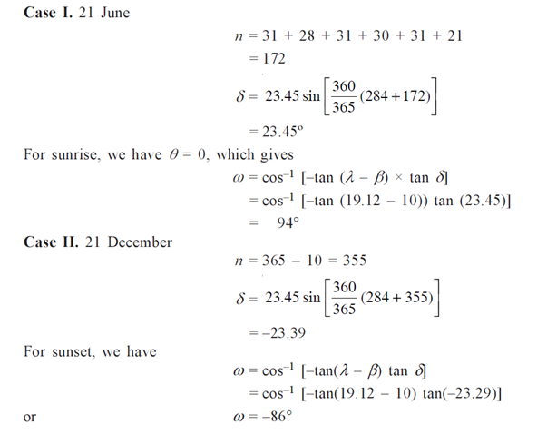
4. Calculate the hour angle at sunrise and sunset on 21 June and 21 December for a surface inclined at an angle of 10º and facing due south (γ = 0). The surface is located in Mumbai (19º07' N, 72º51' E).
Solution:

Slide 31
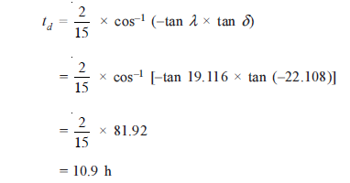
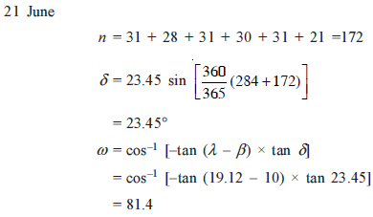
5. Calculate the day light in hours in Mumbai on 1 December if latitude = 19.116 ° and declination angle = –22.108°.
Solution:
6. Calculate hour angle at sunrise on 21 June for a surface tilted at 10° and facing due south. The location has latitude 19° 07’ N and longitude 72° 51’ E.
Solution:

Slide 32
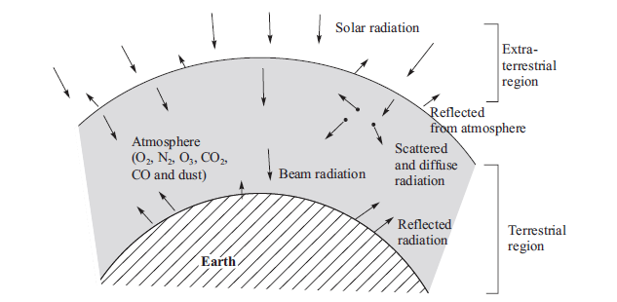
Types of solar radiation:
Extraterrestrial radiation
Beam radiation
Diffuse radiation
Total or global radiation
Terrestrial radiation
Extraterrestrial radiation:
Solar radiation incident on the outer atmosphere of the earth is called extraterrestrial radiation.
From extraterrestrial region, the solar radiation reaches earth's surface in two ways:
Beam radiation
Diffuse radiation
Fig: Different types of solar radiation

Slide 33
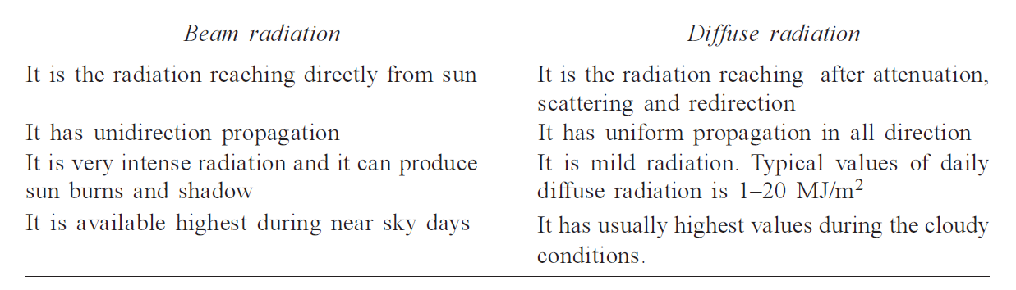
Beam radiation:
A part of sun’s radiation travels through earth’s atmosphere and its reaches directly, which is called direct or beam radiation
Diffuse radiation:
This radiation reaching earth’s surface by the mechanism of scattering and reflecting, that is, reradiation, is called diffuse or sky radiation.
Total or global radiation:
Total or global radiation at any location on earth’s surface is the sum of beam radiation and diffuse radiation.
Total radiation=Beam radiation + Diffuse radiation
Table: Difference between beam radiation and diffuse radiation

Slide 34
Terrestrial radiation:
The solar radiation that reaches earth’s surface after passing through earth’s atmosphere is called terrestrial radiation.
Attenuation:
Atmospheric attenuation is a reduction in the intensity of electromagnetic radiation in the earth’s atmosphere as a result of the absorption and scattering of the radiation.
Solar irradiance:
It is the power per unit area received from the Sun in the form of electromagnetic radiation.

Slide 35
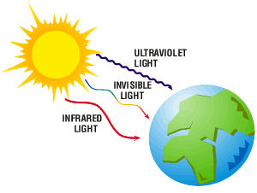
Solar radiation data:
Solar radiation is radiant energy emitted by the sun from a nuclear fusion reaction that creates electromagnetic energy.”
Solar radiation is made up of the following types of rays:
Infrared (IR): Infrared radiation provides heat and represents 49% of solar radiation.
Visible rays (VI): Visible rays represent 43% of radiation and provide light.
Ultraviolet rays (UV radiation): Ultraviolet rays represent 7%.
Other types of rays: Other types of rays represent about 1% of the total.

Slide 36
Radiation measuring instruments:
Solar Radiation nothing but the radiant energy emitted by the sun in the form of electromagnetic waves. Radiation measuring instruments are used to measure or detect this radiation. The effective and frequently used instruments for measuring solar radiation and sun shine are:
Pyranometer
Pyrheliometer
Sunshine recorder
Pyranometer:
Pyranometer is a Greek word composed of Pyr (fire) + ano (something above) + meter (measurement), which means “measuring fire from above”, that is, measuring sun’s radiation.
A pyranometer is radiation energy measuring device which is designed to measure global or total radiation and diffuse radiation usually on horizontal plane but it can also be used to measure on an inclined plane.

Slide 37
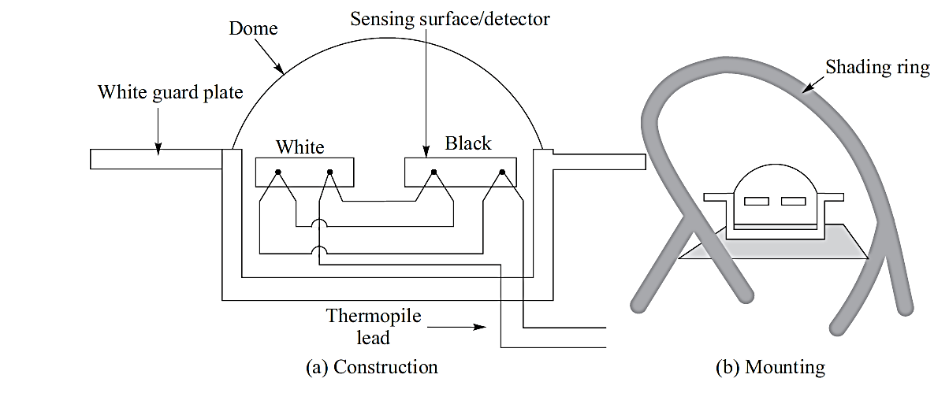
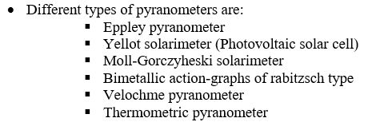
Fig: Pyranometer
It consists of a thermopile whose sensitive surface has circular blackened, hot junction exposed to sun and the cold junction completely shaded.
A sensor is provided to sense the radiations emitted by sun, which is covered by concentric hemi-spherical glass domes in order to prevent it from wind and rain.
A shaded ring placed at 0.3 meters is provided to prevent the direct fall of beam radiation on to the sensor and to measure the diffuse components of radiation.

Slide 38
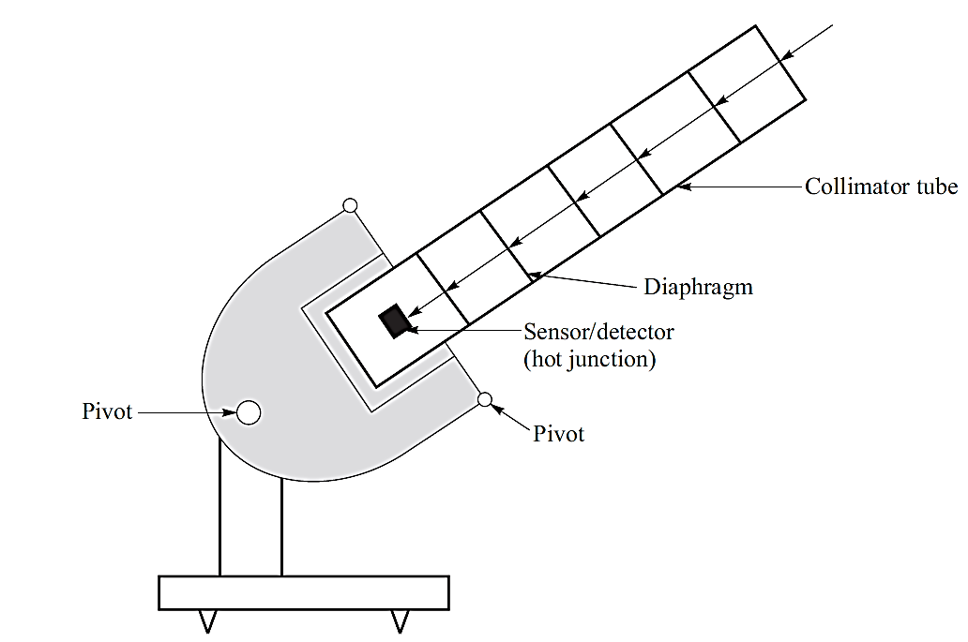
Pyrheliometer:
It is an instrument to measure beam radiation.
It has a narrow long tube called collimator tube to collect beam radiation from the sun at normal incidence.
A tracker is provided in the instrument to keep the collimator tube continuously face the sun rays for the measurement.
Three types of pyrheliometers are usually used to measure the incident beam radiation, which are:
The Angstrom compensation pyrheliometer
The Abbot silver disc pyrheliometer
Eppley pyrheliometer
Fig: Pyrheliometer

Slide 39
Differences between pyranometer and pyrheliometer:
Pyranometer is a dome like structure that measures diffused sun energy while pyrheliometer is an instrument that measures direct sun’s energy.
Both are often used in conjunction in meteorological research stations.
While pyranometer measures global solar radiation, pyrheliometer measures direct solar irradiance.
Pyrheliometer is used for measuring the intensity of direct solar radiation at normal incidence, whereas pyranometer is used for measuring global solar radiation received from the entire atmosphere.
In pyrheliometer the sensor disc is located at the base of the tube, whose axis is aligned with the direction of the sun rays, thus, blocking the diffuse radiation from sensor surface.
In case of a pyranometer, the beam radiation is prevented from falling on instrument sensor disc, thus measuring diffuse radiation.

Slide 40
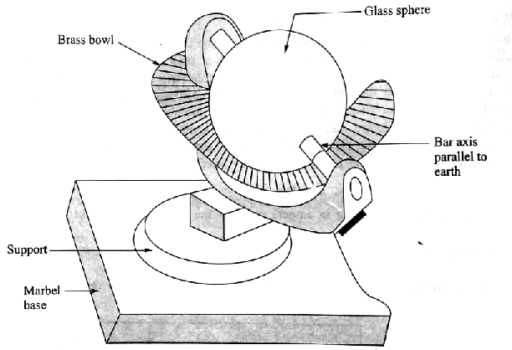
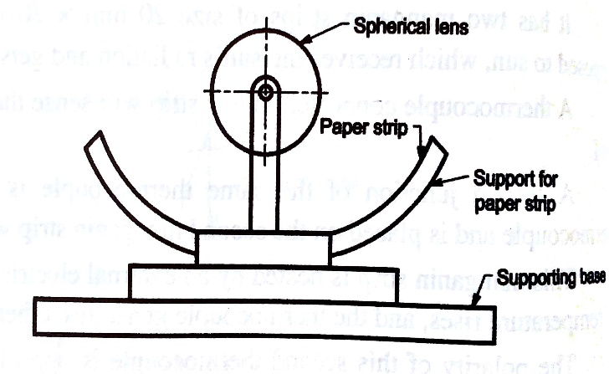
Sunshine recorder:
The instrument is used to measure the duration of bright sunshine hours in a day.
It mainly consists of a glass sphere (diameter = l0 cm) mounted on its axis parallel to the axis of earth within a spherical section called bowl as shown in Figure.
The bowl and glass sphere are arranged in such a way that sun’s rays are focused sharply as a spot-on recording paper card held in a groove in the bowl.
The card is made of a special coated paper with the printed time scale.
The paper card has the property to burn a spot wherever sun’s rays fall on it.
The length of the trace formed by the burn spots on the card paper is the measure of the duration of sunshine hours in a day.
Fig: Sunshine recorder

Slide 41
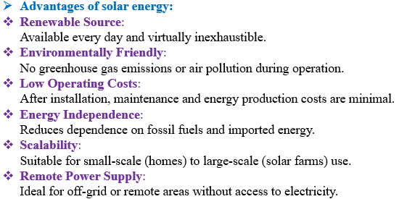
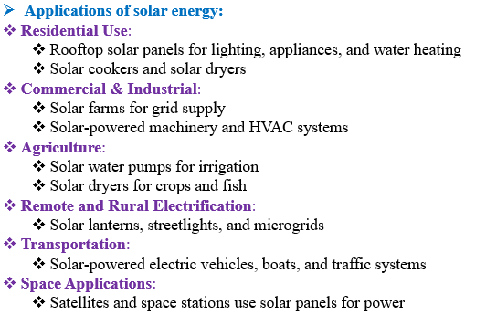
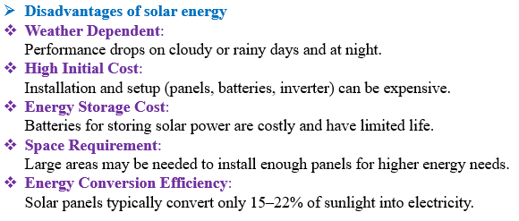

Slide 42
Model questions
Illustrate the role and potential of new and renewable sources.
Demonstrate the structure of the sun.
Elaborate solar-earth angles with neat sketch.
List out the solar radiation measuring instruments. Explain any one with neat sketch.
Discuss the working of sunshine recorder with neat sketch.
Calculate the hour angle at sunrise and sunset on 21 June and 21 December for a surface inclined at an angle of 10º and facing due south (γ = 0). The surface is located in Mumbai (19º07' N, 72º51' E).
Short answer questions
What is the major major difference between sustainable and unsustainable energy sources.
Define solar energy.
List out the advantages of solar energy.
State the environmental impacts of solar power.
What are the extraterrestrial and terrestrial solar radiations.
Assignment questions
Illustrate the coordinate systems and coordinates of the sun.
Analyze the solar radiation on titled surface.

